Slide 1
Group Project Presentation
James Shaw, John Vos, Ross Jones and Jack Whitchurch

Slide 2

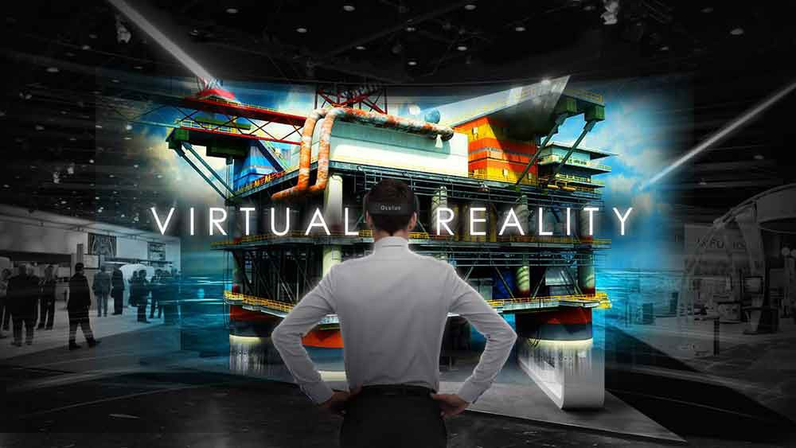
Introduction
Notes:
Introduce the game concept
Space theme
Escape room
Tutorial room
6 puzzles to escape the main room
Potentially more levels included in a final release

Slide 3

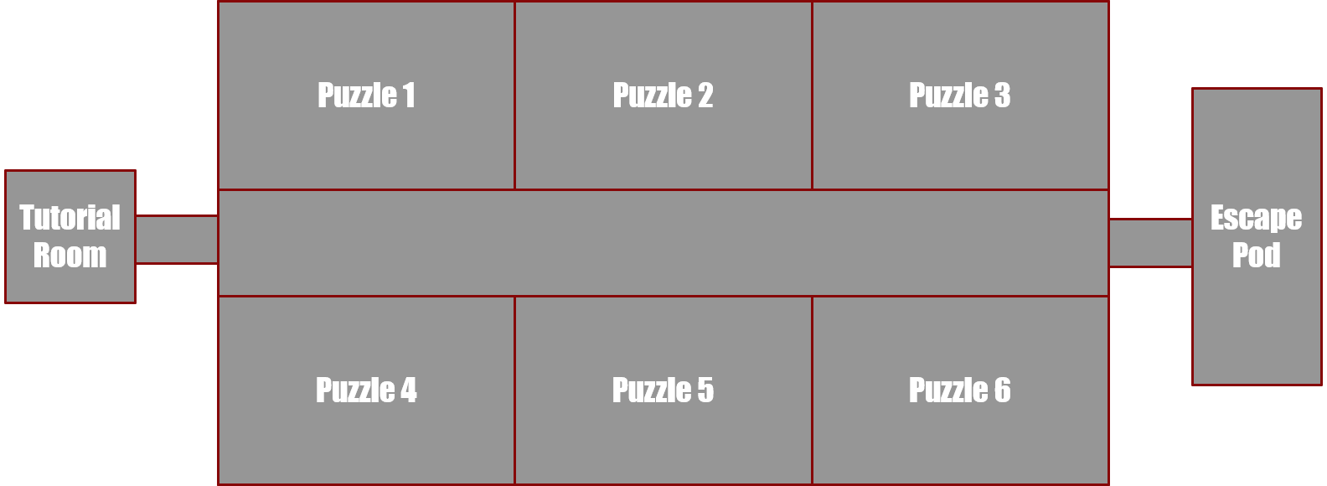
Game Layout
Notes:
Planned game map for this release

Slide 4
Project Plan
1 hour to complete entire game.
8 minutes per room, if no progress in 3 minutes a hint will be given.
Rooms can be done in any order though they will have a number above each door to indicate order.

Slide 5
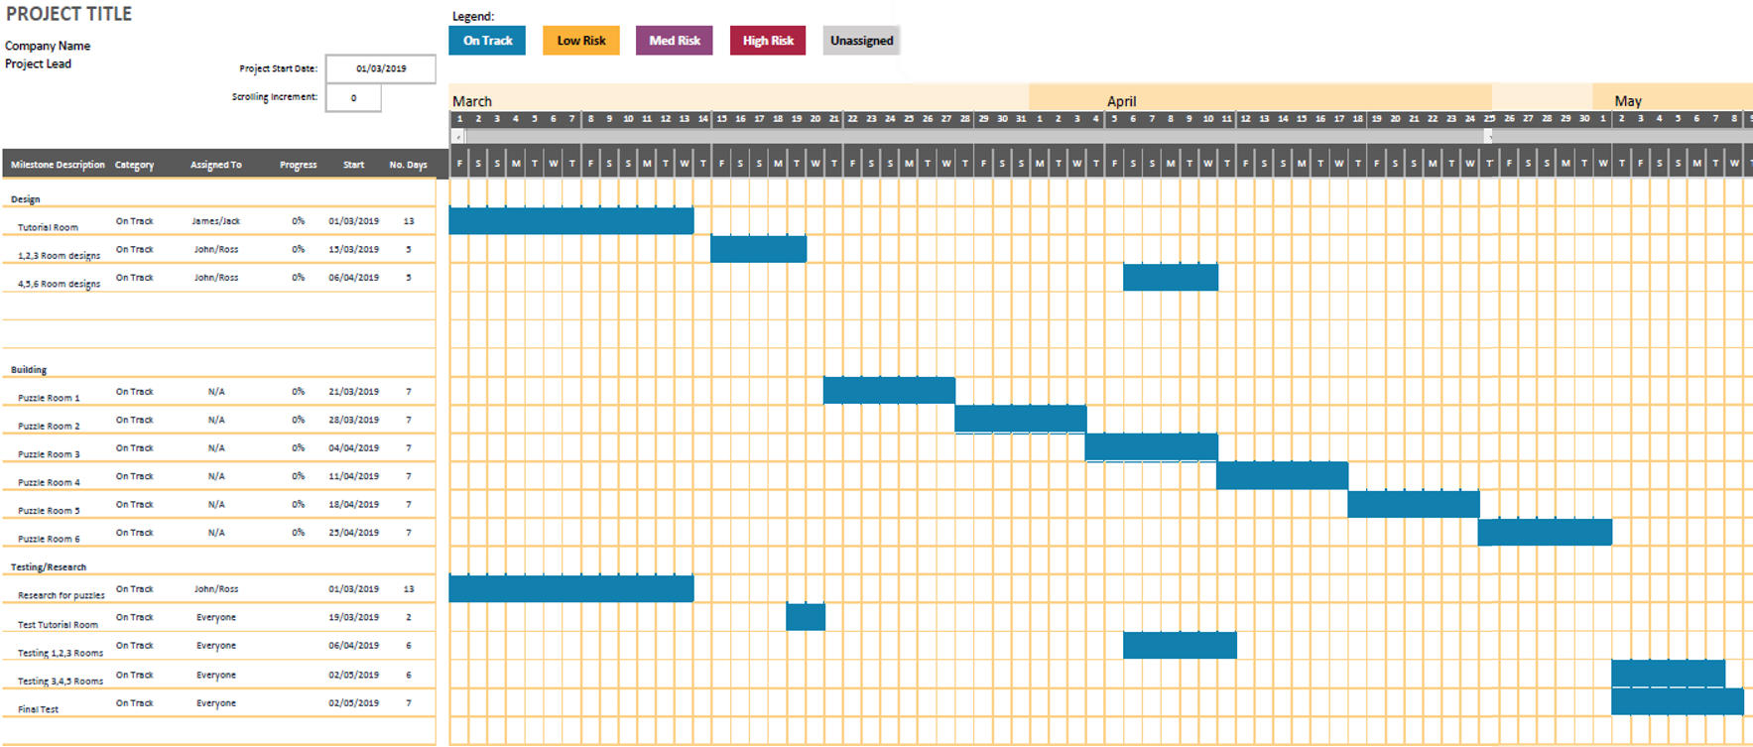
Project Timeline
Notes:
Also using Trello to track tasks being done

Slide 6

Unity (2018.3.6) VR for windows using Vive VR set.
Unity Standard Assets Package
Using HTC Vive VR set for testing, although this should work with any vr headset
Using Blender to make some assets that may not be in Unity.

Slide 7
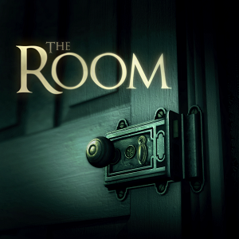


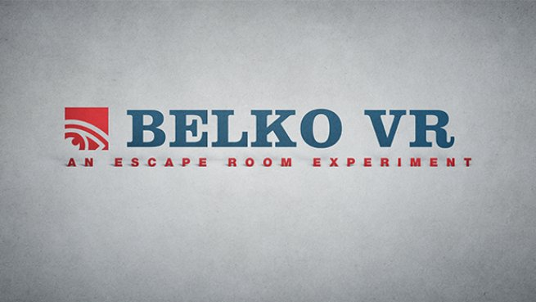

Research
Looking at other puzzle games to see how their hint system works
The Room
Playing other VR Escape Rooms
Belko VR: An Escape Room Experience
Space Panic: Room Escape
Going to Physical escape rooms
Pier Pressure – Brighton
GR8Escape - York
Notes:
Looked at other puzzle games
Many use a currency system
Coins gained from completing puzzles that can be used to redeem hints
Some use a time system
Automatically gives you a hint after a set amount of time
Looked at other VR escape rooms to see what mechanics they used
Went to physical escape rooms to see what types of puzzles we could use in a VR setting.

Slide 8

Usability / UX Test plan
Running frequent tests of the game with a member of our target audience
Get other experienced vr users to test the game to see how it compares to other games they have played
Ensure that testing is done throughout the whole development process with the end user in mind

Slide 9
Team Roles
James: Main Programmer
Responsible for programming any relevant code and adjusting elements in unity
John: Admin and Room Design
Responsible for writing documentation and designing the visual look of the game
Ross: 3D Asset Designer and Room Design
Responsible for creating 3D assets on Blender and assisting in designing the visual look of the game
Jack: Programmer and Sound Effects
Responsible for helping with programming and developing sound effects

